Slide 1

Social Science Research Design and Statistics, 2/e Alfred P. Rovai, Jason D. Baker, and Michael K. Ponton
Creating a Histogram Using
Chart Builder
PowerPoint Prepared by Alfred P. Rovai
IBM® SPSS® Screen Prints Courtesy of International Business Machines Corporation,
© International Business Machines Corporation.

Slide 2
Creating a Histogram Using Chart Builder
A histogram is an example of a frequency curve that depicts a univariate dataset. It is constructed by dividing the range of continuous data into equal-sized adjacent bins. For each bin, a rectangle is constructed with an area proportional to the number of observations falling into that bin.
Bins are plotted on the x-axis and frequencies (the number of cases accumulated in each bin) are plotted on the y-axis.
Histograms are similar to bar charts. However, with bar charts, each column represents a group defined by a categorical variable. In contrast, with histograms, each column represents a group defined by a continuous variable. Typically, there are no spaces between columns in a histogram while bar charts include spaces.
Histograms are useful in evaluating:
The shape of a distribution
Symmetry, skewness, and kurtosis
Modality
Presence of outliers

Slide 3
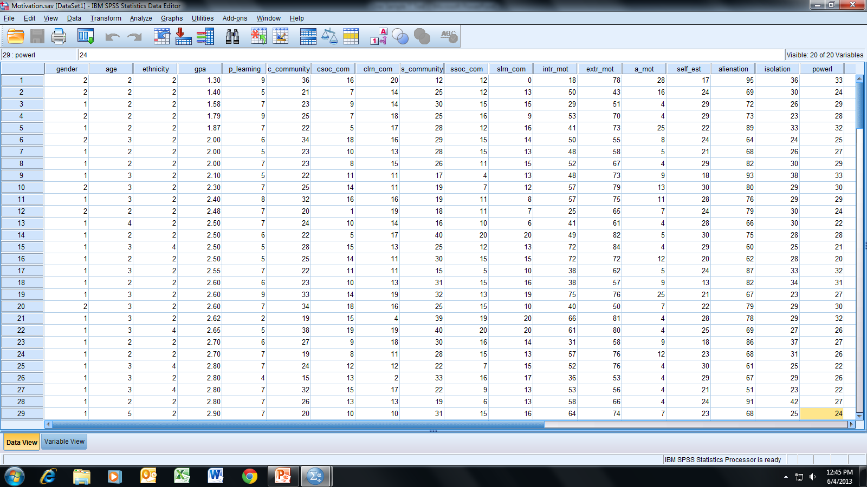
Open the dataset Motivation.sav.
File available at http://www.watertreepress.com/stats
TASK
Create a histogram of
alienation with a normal curve overlay using Chart Builder.*
Note: *Alternatively, SPSS Legacy Dialogs can be used.

Slide 4
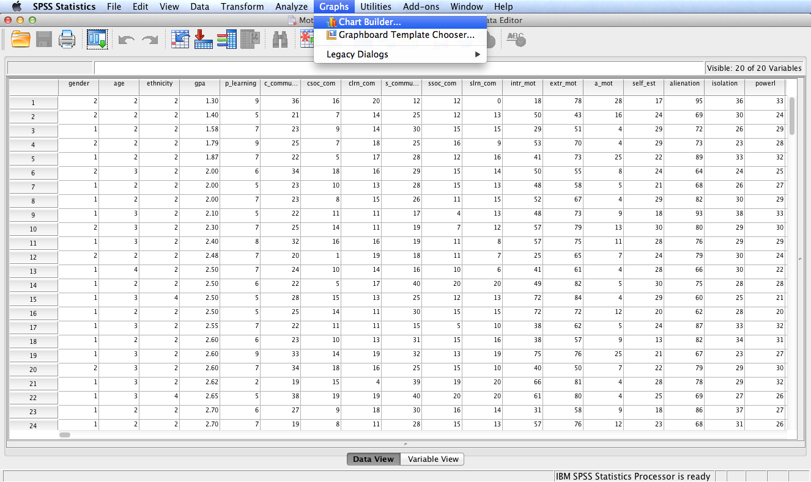
Follow the menu as indicated.

Slide 5
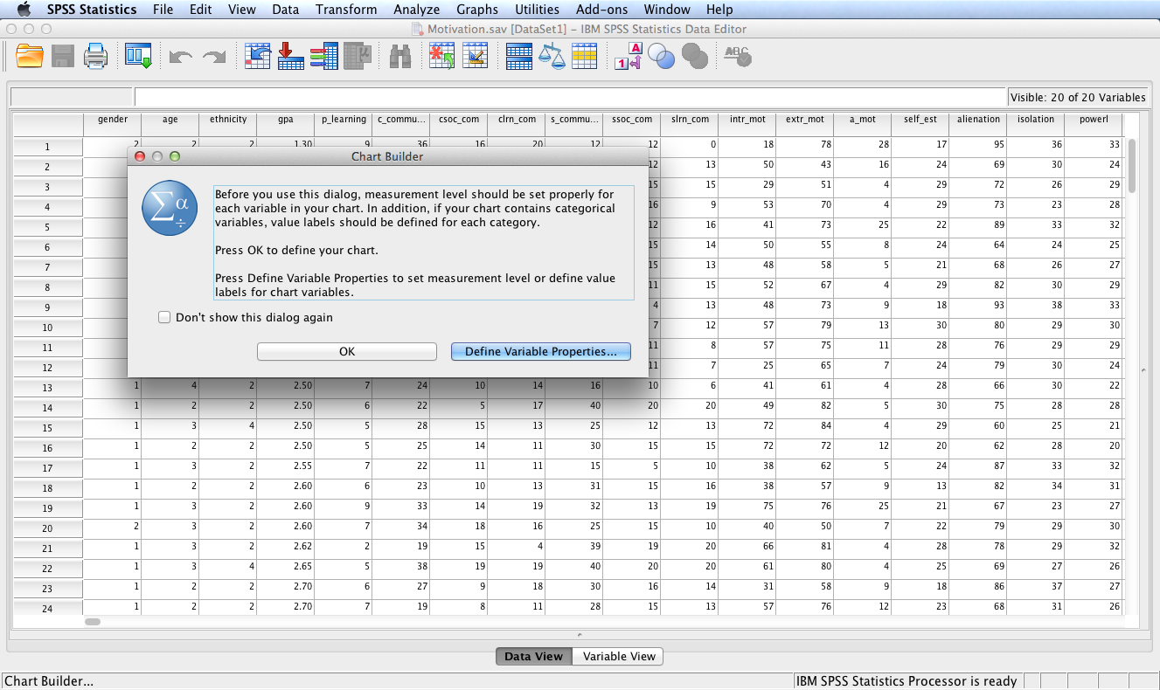
Click Define Variable Properties… if you need to label variable values and/or set other properties. Otherwise, click OK.
For this example, click Define Variable Properties…

Slide 6
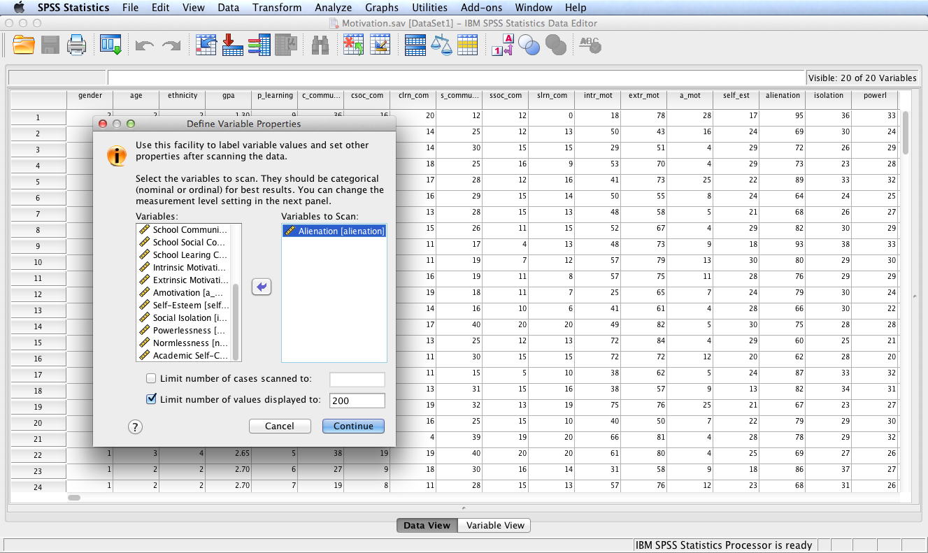
Move Alienation from the Variables: box to the Variables to Scan: box. Click Continue.

Slide 7
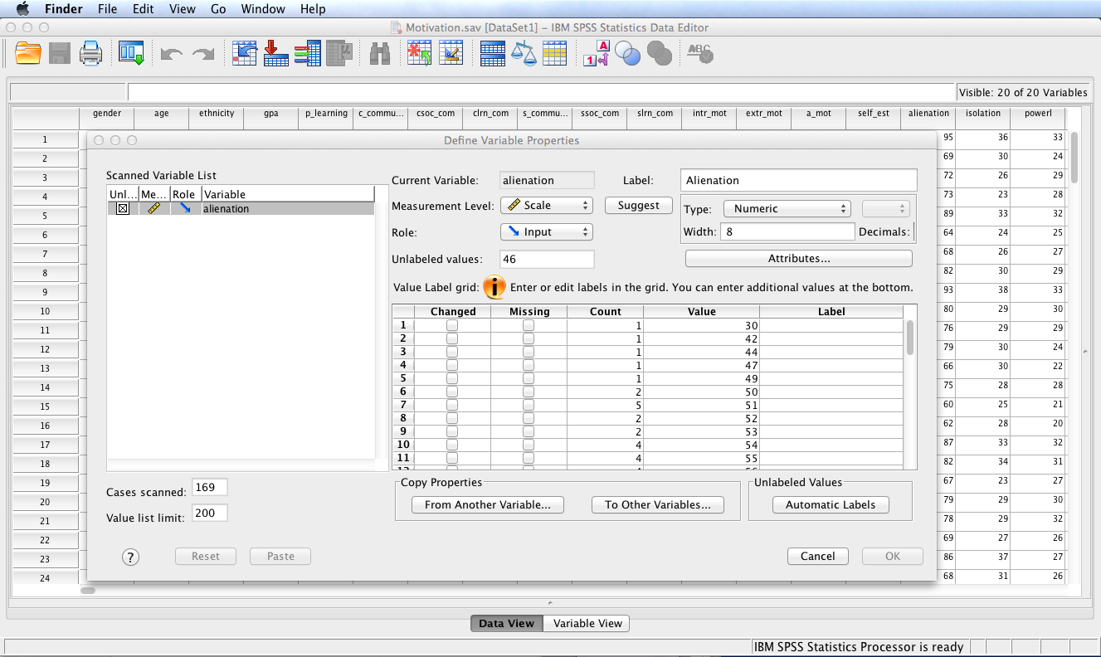
Note the options provided. Click Cancel as variable properties do not need to be changed.

Slide 8
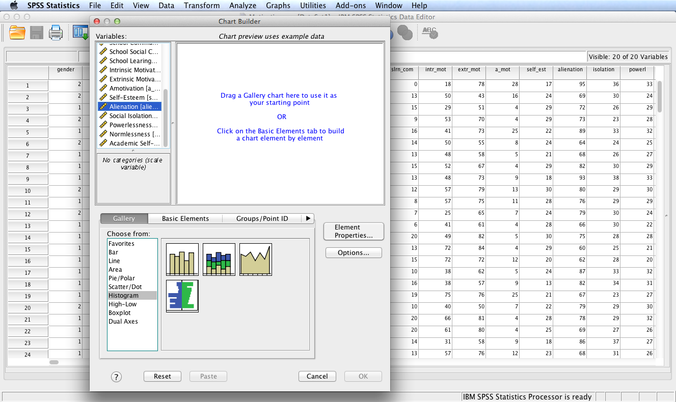
Select Alienation and Histogram. Note the Gallery displays various types of histograms: simple, stacked, frequency polygons, and population pyramids.

Slide 9
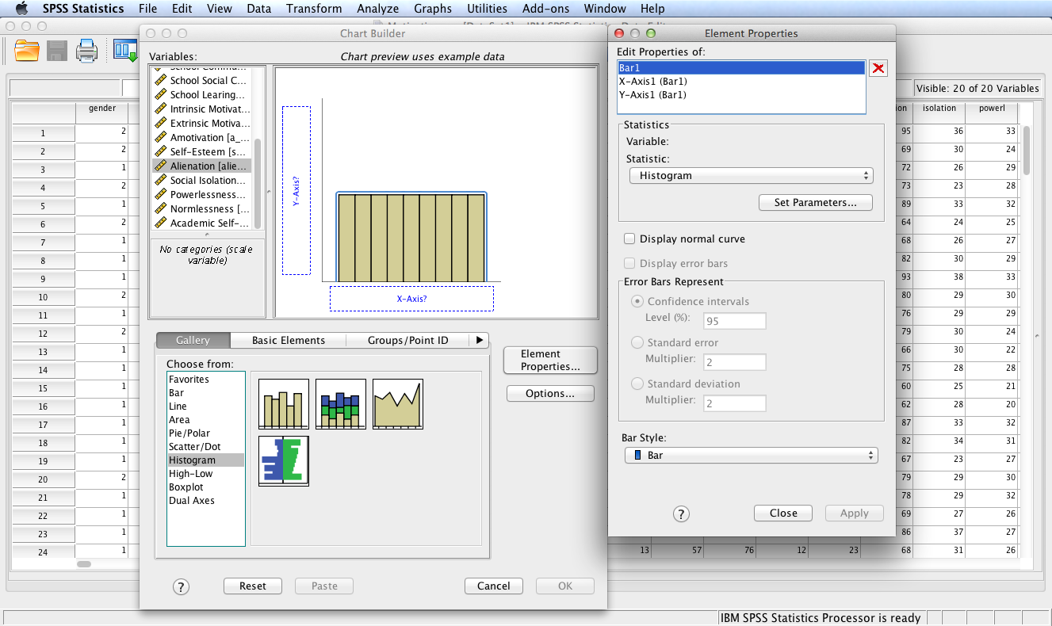
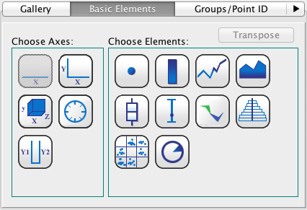
Drag and drop the simple histogram onto the canvas. (Alternatively, drop basic elements as displayed below onto the canvas.) As you build the histogram, SPSS uses randomly generated data to provide a rough sketch of how the histogram will look.

Slide 10
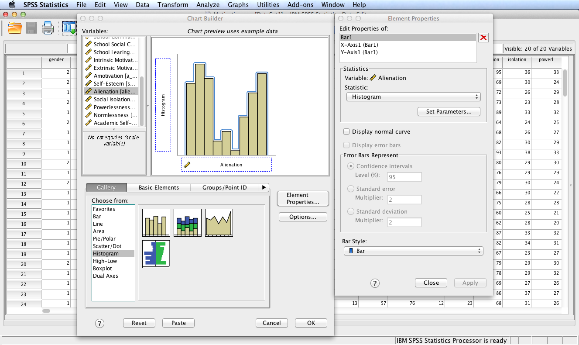
Select and drag Alienation from the Variables: box and drop it on the X-Axis? box.

Slide 11
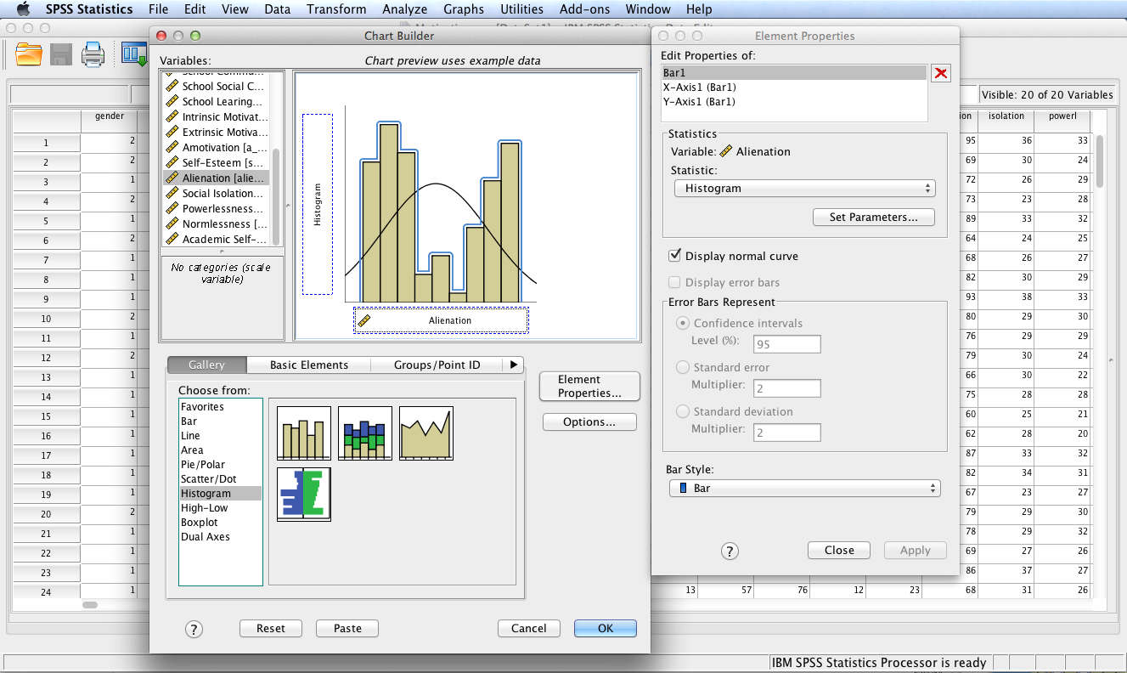
Check Display normal curve box and click Apply. Note the modified histogram on the canvas.

Slide 12
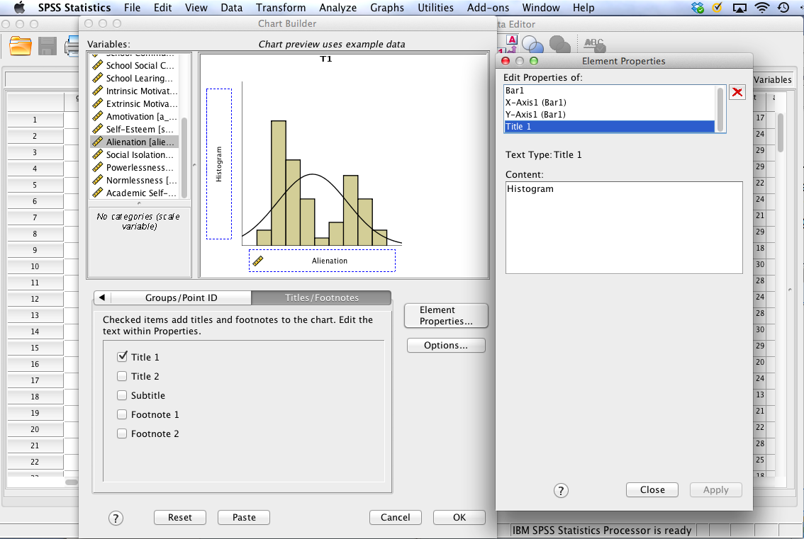
Select Titles/Footnotes, check Title 1, and enter a title in the Content: box. Click Apply.

Slide 13
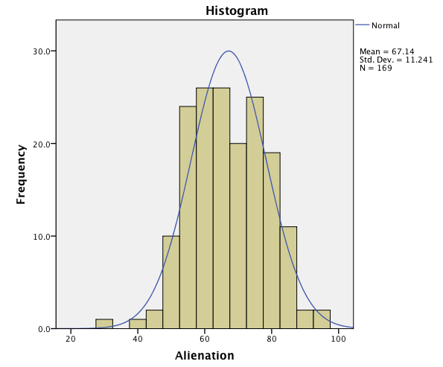
SPSS Output
The constructed histogram is displayed in the SPSS output window.
To copy the graph, click on it to highlight it and select Copy from the SPSS Edit menu. You can now paste the histogram in a word processing document.
The Chart Editor can be used to change the appearance of the histogram. Simply double click the chart in the SPSS Output window to launch the Chart Editor.

Slide 14
End of Presentation

